Slide 1
AngularJS For beginners
Santosh Kumar Kar

Slide 2
What is AngularJS
JavaScript MVC framework for the Web
pure JavaScript and HTML
Unit Testable
For Web and Mobile
Less code
Can integrate 3rd party libraries such as jQueryUI/BootStrap

Slide 3
MVC
The model is the driving force of the application. This is generally the data behind the application, usually fetched from the server. Any UI with data that the user sees is derived from the model, or a subset of the model.
The view is the UI that the user sees and interacts with. It is dynamic, and generated based on the current model of the application
The controller is the business logic and presentation layer, which performs actions such as fetching data, and makes decisions such as how to present the model, which parts of it to display, etc.

Slide 4
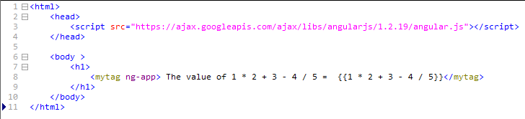
First Application ng-app

Slide 5
AngularJS Directives
Markers on DOM elements (such as elements, attributes, css, and more).
Used to create custom HTML tags that serve as new, custom widgets.
AngularJS has built-in directives (ngBind, ngModel...)

Slide 6
directive ng-app
first and most important directive
Tells the section of HTML that AngularJS controls
Need to put in any tag, preferable at <html> or <body>
Anything outside of the tag would not be processed

Slide 7
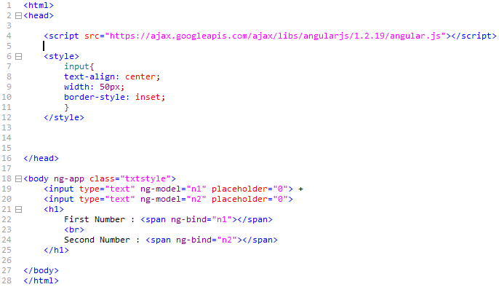
directive ng-model, ng-bind

Slide 8
directive ng-model
used with input fields, user to enter any data and get access to the value in JavaScript.
In ng-model="n1", AngularJS stores the value that the user types into in a variable called "n1"

Slide 9
directive ng-bind
Binds with the Angular JS variable
ng-bind in <span>
<span ng-bind="n1"
is similar to
{{n1}}

Slide 10
Modules
Modules in AngularJS are similar to packages in java
Container for the different parts of your app – controllers, services, filters, directives, etc.
Can define its own controllers, services, factories, and directives which are accessed throughout the module.
Can depend on other modules as dependencies and made available to all the code defined in this module.

Slide 11
Modules
Module name we define
Array of dependent modules
angular.module(‘myApp', []);
Creating a module with no dependencies
angular.module(‘myApp', ['myapp.ui', 'yourapp.diagram']);
Creating a module with 2 other dependent modules
angular.module(‘myApp');
looks an existing module to make it available to use, add, or modify in the current file.

Slide 12
Controller
Fetch data from the server for UI
Are regular JavaScript Objects.
ng-controller directive defines the application controller.

Slide 13
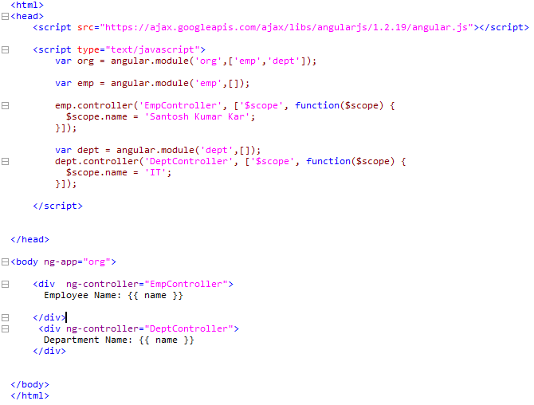
Parent module
Child modules
Defined 2 Controllers
Using parent module only

Slide 14
controllerAs
Can be used in AngularJS 1.2 and later
Allows to define the variables on the controller instance using the this keyword instead of $scope
Directly can be referred through the controller from the HTML

Slide 15
controllerAs
$scope.name = 'some value'
changed to
this.name = 'some value';
ng-controller="EmpController"
changed to
ng-controller="EmpController as emp"
{{ name }}
changed to
{{ emp.name }}

Slide 16
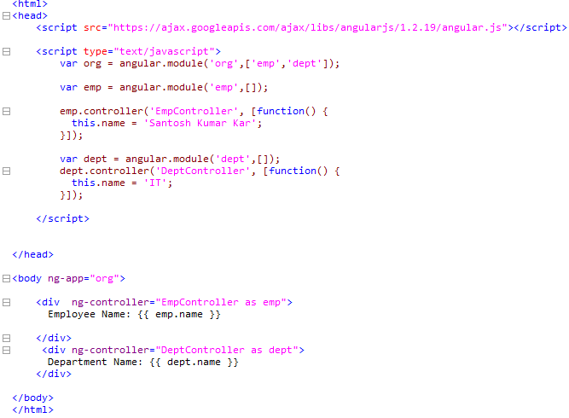

Slide 17
directive ng-repeat
Similar to for each loop
Allows to iterate over an array
Allows to iterate over keys and values of an object
Syntax: ng-repeat="eachVar in arrayVar"

Slide 18
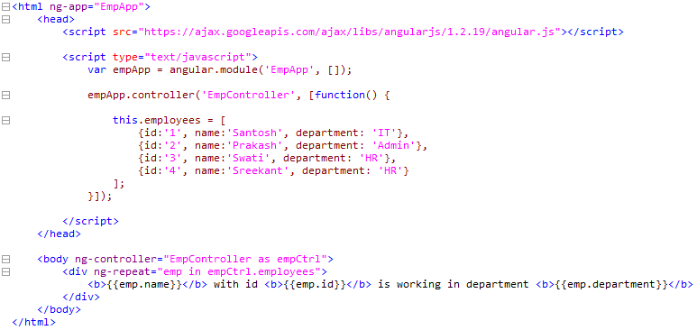

Slide 19
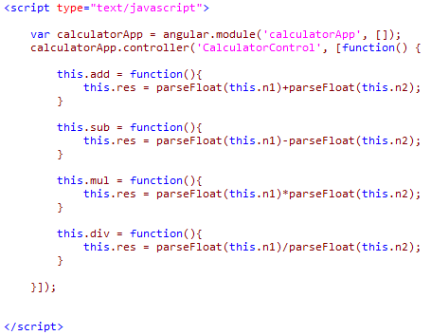
Calculator

Slide 20
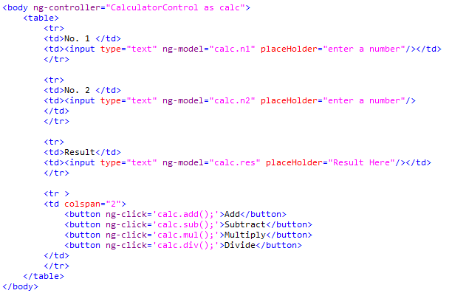
Calculator

Slide 21
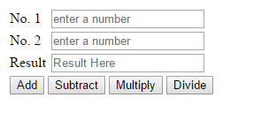
Calculator

Slide 22
Forms
ng-submit
ng-disabled = "myForm.$invalid"
required

Slide 23
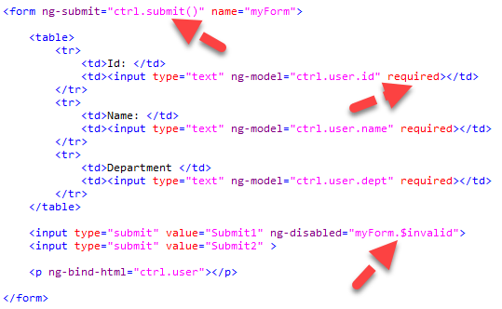
form

Slide 24
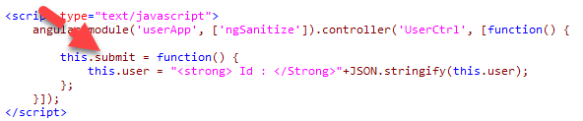
JS

Slide 25
Error Handling
Form validation
required
ng-required
ng-minlength
ng-maxlength
ng-pattern
type="email"
type="number"
type="date"
type="url"

Slide 26
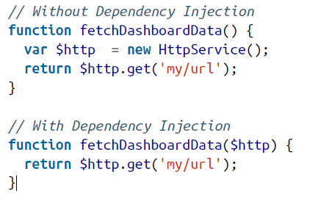
Dependency Injection
Any service known to AngularJS can be injected into any other service, directive, or controller by stating it as a dependency.
AngularJS will automatically create the entire chain before injecting.

Slide 27
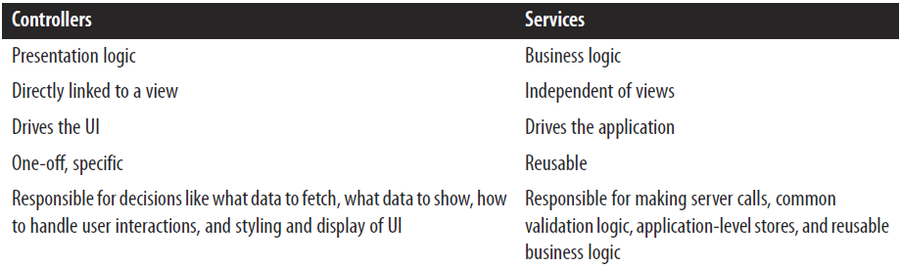
Controller vs Services

Slide 28
Services
Service that is a reusable API or substitutable objects, which can be shared across our applications.
A service in AngularJS can be implemented as a
factory
service
provider

Slide 29
Service types
Build-in
Custom

Slide 30
Common built-In Services
$window
$log
$http
$location
$timeout
$interval
Points to remember:
AngularJS prefixes all the services that are provided by the AngularJS library with the $ sign.
when you create your own services, do not prefix them with a $ sign. It will just end up confusing you and your team at some point in time

Slide 31
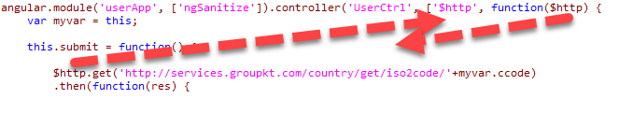

Injecting service
Order of Injection

Slide 32
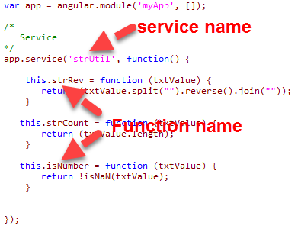
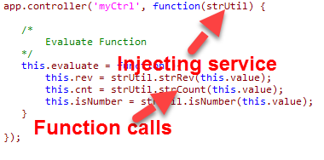
Creating Our Own Service

Slide 33
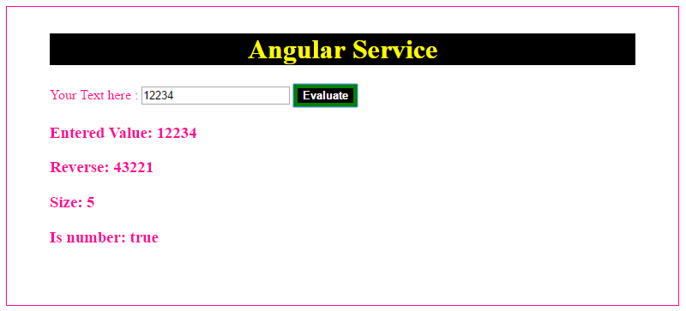
Creating your own service

